Slide 1
Unit 7 Clustering
Machine Learning
https://www.javatpoint.com/clustering-in-machine-learning

Slide 2
Clustering in Machine Learning (1/3)
Clustering or cluster analysis is a machine learning technique, which groups the unlabelled dataset.
It can be defined as a way of grouping the data points into different clusters, consisting of similar data points.
The objects with the possible similarities remain in a group that has less or no similarities with another group.

Slide 3
Clustering in Machine Learning (2/3)
It does it by finding some similar patterns in the unlabelled dataset such as shape, size, color, behavior, etc.
It divides them as per the presence and absence of those similar patterns.
It is an unsupervised learning method, hence no supervision is provided to the algorithm, and it deals with the unlabeled dataset.
After applying this clustering technique, each cluster or group is provided with a cluster-ID.

Slide 4
Clustering in Machine Learning (3/3)
ML system can use this id to simplify the processing of large and complex datasets.
The clustering technique is commonly used for statistical data analysis.
Clustering is somewhere similar to the classification algorithm, but the difference is the type of dataset that we are using.
In classification, we work with the labeled data set, whereas in clustering, we work with the unlabelled dataset.

Slide 5
Clustering Technique
The clustering technique can be widely used in various tasks. Some most common uses of this technique are:
  Market Segmentation
  Statistical data analysis
  Social network analysis
  Image segmentation
  Anomaly detection, etc.

Slide 6
Clustering Examples (1/3)
Example, in shopping mall, the things with similar usage are grouped together.
  t-shirts section, trousers sections, vegetable sections, apples, bananas, Mangoes, etc.
The clustering technique also works in the same way.
Other examples of clustering are grouping documents according to the topic.

Slide 7
Clustering Examples (2/3)
Amazon recommendation system provides the recommendations as per the past search of products.
Netflix also uses this technique to recommend the movies and web-series to its users as per the watch history.

Slide 8
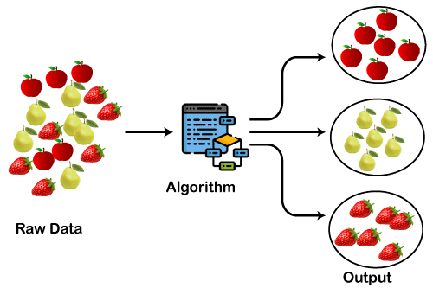
Clustering Examples (3/3)
The different fruits are divided into several groups with similar properties by clustering algorithm.

Slide 9
Types of Clustering Methods (1/2)
The clustering methods are broadly divided into
  Hard clustering (datapoint belongs to only one group) and
  Soft Clustering (data points can belong to another group also).

Slide 10
Types of Clustering Methods (2/2)
The main clustering methods used in Machine learning:
  Partitioning Clustering
  Density-Based Clustering
  Distribution Model-Based Clustering
  Hierarchical Clustering
  Fuzzy Clustering

Slide 11
Partitioning Clustering (1/2)
It is a type of clustering that divides the data into non-hierarchical groups.
It is also known as the centroid-based method.
The most common example of partitioning clustering is the K-Means Clustering algorithm.
In this type, the dataset is divided into a set of k groups, where K is used to define the number of pre-defined groups.

Slide 12
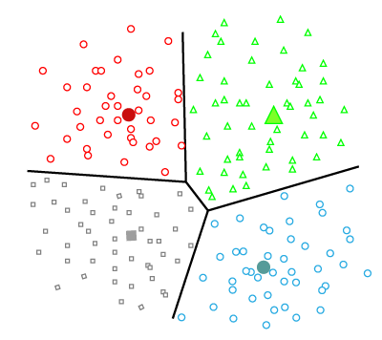
Partitioning Clustering (2/2)
The cluster center is created in such a way that the distance between the data points of one cluster is minimum as compared to another cluster centroid.

Slide 13
Density-Based Clustering (1/2)
The density-based clustering method connects the highly-dense areas into clusters, and the arbitrarily shaped distributions are formed as long as the dense region can be connected.
This algorithm does it by identifying different clusters in the dataset and connects the areas of high densities into clusters.
The dense areas in data space are divided from each other by sparser areas.

Slide 14
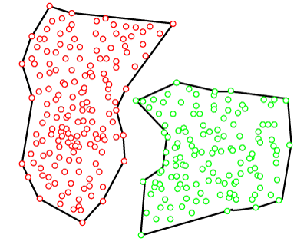
Density-Based Clustering (2/2)
These algorithms can face difficulty in clustering the data points if the dataset has varying densities and high dimensions.

Slide 15
Distribution Model-Based Clustering (1/2)
In the distribution model-based clustering method, the data is divided based on the probability of how a dataset belongs to a particular distribution.
The grouping is done by assuming some distributions commonly Gaussian Distribution.

Slide 16
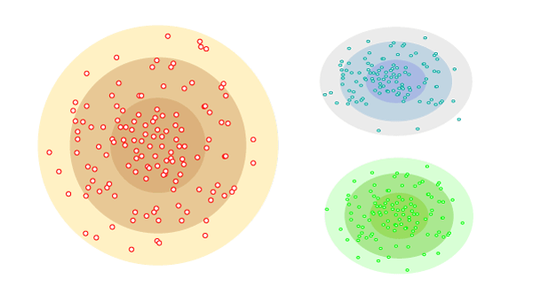
Distribution Model-Based Clustering (2/2)
The example of this type is the Expectation-Maximization Clustering algorithm that uses Gaussian Mixture Models (GMM).

Slide 17
Hierarchical Clustering (1/2)
Hierarchical clustering can be used as an alternative for the partitioned clustering as there is no requirement of pre-specifying the number of clusters to be created.
In this technique, the dataset is divided into clusters to create a tree-like structure, which is also called a dendrogram.

Slide 18
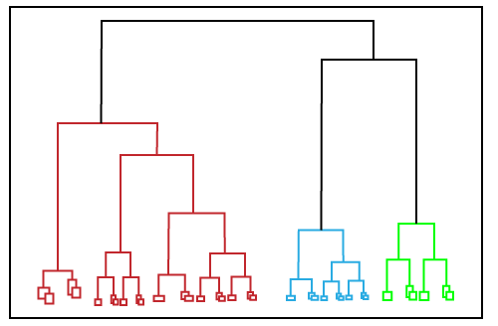
Hierarchical Clustering (2/2)
The observations or any number of clusters can be selected by cutting the tree at the correct level.
The most common example of this method is the Agglomerative Hierarchical algorithm.

Slide 19
Fuzzy Clustering
Fuzzy clustering is a type of soft method in which a data object may belong to more than one group or cluster.
Each dataset has a set of membership coefficients, which depend on the degree of membership to be in a cluster.
Fuzzy C-means algorithm is the example of this type of clustering; it is sometimes also known as the Fuzzy k-means algorithm

Slide 20
Clustering Algorithms (1/2)
The Clustering algorithms can be divided based on their models that are explained above.
There are different types of clustering algorithms published, but only a few are commonly used.
The clustering algorithm is based on the kind of data that we are using.
Such as, some algorithms need to guess the number of clusters in the given dataset, whereas some are required to find the minimum distance between the observation of the dataset.

Slide 21
Clustering Algorithms (2/2)
The popular Clustering algorithms that are widely used in machine learning:
  K-Means algorithm
  Mean-shift algorithm
  DBSCAN Algorithm
  Expectation-Maximization Clustering using GMM
  Agglomerative Hierarchical algorithm
  Affinity Propagation

Slide 22
K-Means algorithm
The k-means algorithm is one of the most popular clustering algorithms.
It classifies the dataset by dividing the samples into different clusters of equal variances.
The number of clusters must be specified in this algorithm.
It is fast with fewer computations required, with the linear complexity of O(n).

Slide 23
Mean-shift algorithm
Mean-shift algorithm tries to find the dense areas in the smooth density of data points.
It is an example of a centroid-based model,
It works on updating the candidates for centroid to be the center of the points within a given region.

Slide 24
DBSCAN Algorithm
It stands for Density-Based Spatial Clustering of Applications with Noise.
It is an example of a density-based model similar to the mean-shift, but with some remarkable advantages.
In this algorithm, the areas of high density are separated by the areas of low density.
Because of this, the clusters can be found in any arbitrary shape.

Slide 25
Expectation-Maximization
Expectation-Maximization Clustering using GMM: This algorithm can be used as an alternative for the k-means algorithm or for those cases where K-means can be failed.
In GMM, it is assumed that the data points are Gaussian distributed.

Slide 26
Agglomerative Hierarchical algorithm
It performs the bottom-up hierarchical clustering. In this, each data point is treated as a single cluster at the outset and then successively merged.
The cluster hierarchy can be represented as a tree-structure.

Slide 27
Affinity Propagation
It is different from other clustering algorithms as it does not require to specify the number of clusters.
In this, each data point sends a message between the pair of data points until convergence.
It has O(N2T) time complexity, which is the main drawback of this algorithm.

Slide 28
Applications of Clustering (1/4)
Below are some commonly known applications of clustering technique in Machine Learning:
In Identification of Cancer Cells:
  The clustering algorithms are widely used for the identification of cancerous cells.
  It divides the cancerous and non-cancerous data sets into different groups.

Slide 29
Applications of Clustering (2/4)
In Search Engines:
  Search engines also work on the clustering technique.
  The search result appears based on the closest object to the search query.
  It does it by grouping similar data objects in one group that is far from the other dissimilar objects.
  The accurate result of a query depends on the quality of the clustering algorithm used.

Slide 30
Applications of Clustering (3/4)
Customer Segmentation:
  It is used in market research to segment the customers based on their choice and preferences.
In Biology:
  It is used in the biology stream to classify different species of plants and animals using the image recognition technique.

Slide 31
Applications of Clustering (4/4)
In Land Use:
  The clustering technique is used in identifying the area of similar lands use in the GIS database.
  This can be very useful to find that for what purpose the particular land should be used, that means for which purpose it is more suitable.

